Slide 1
Distribution, Channel, and Partnerships
April 29, 2010
Alex Rampell
Founder/CEO
TrialPay, Inc.

Slide 2
Some Background – You Have “Currency” as a Customer
Companies will pay to acquire new customers
You are worth:
$1000 to Comcast
$2000 to GEICO
$100 to Netflix
$300 to AT&T/Sprint/Tmobile/Verizon
…and these companies will pay some % of this to whoever refers you to them

Slide 3
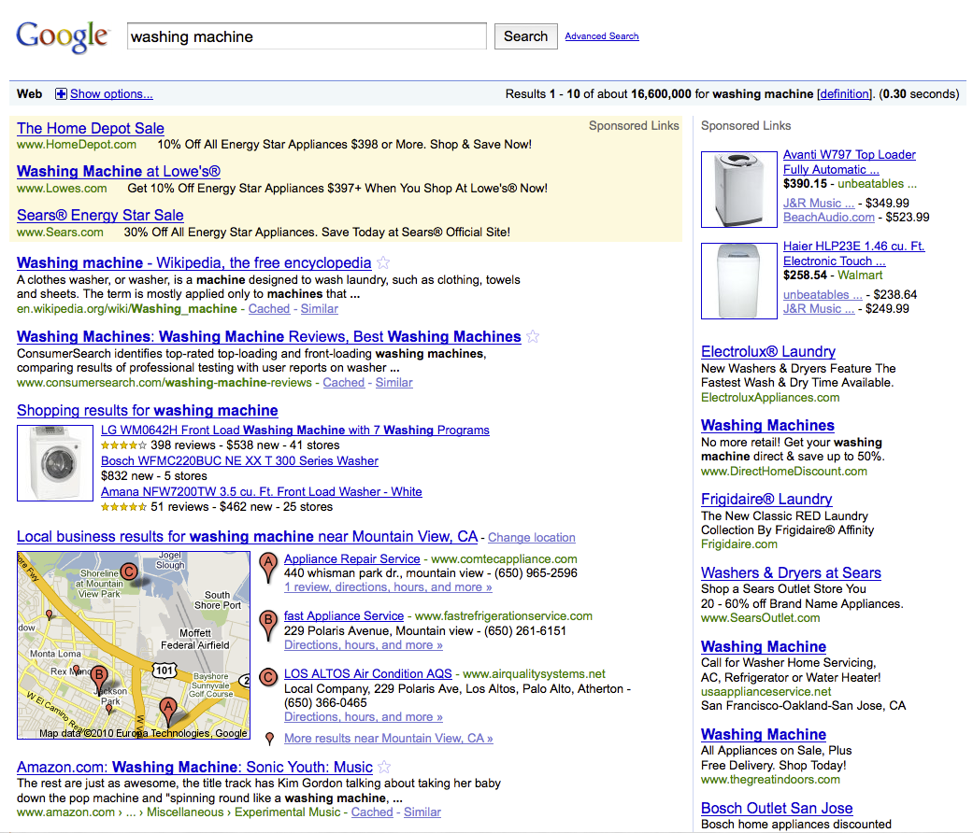
Point-of-Sale is a Huge Untapped Opportunity
Search
Transaction
7B transactions per year

Slide 4


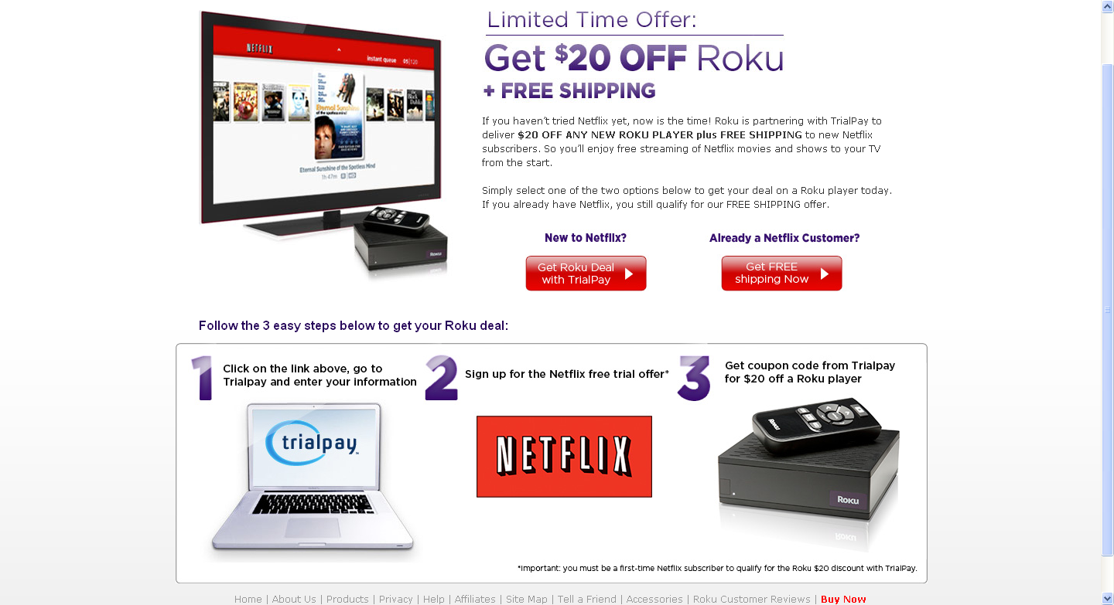
Example: Pre-Transaction Retail Promotions
Pre

Slide 5
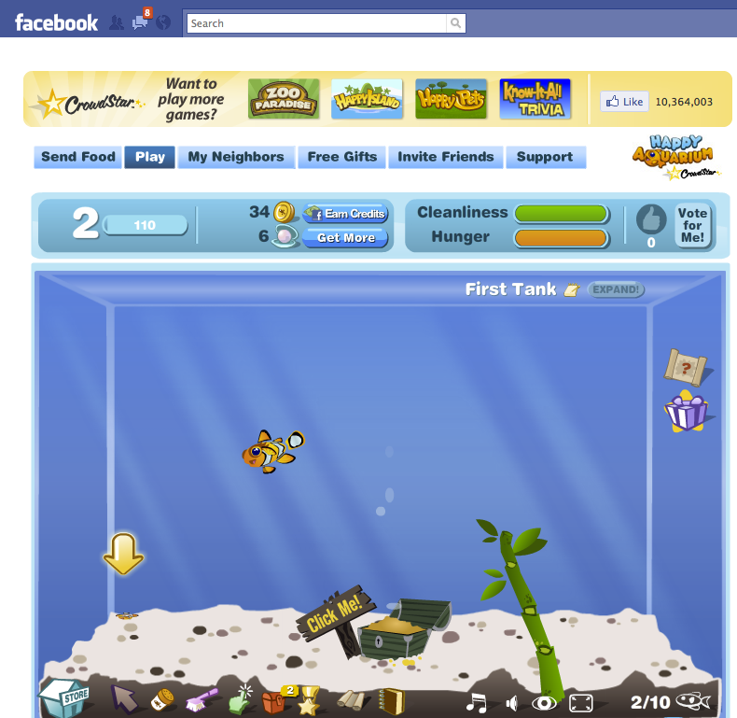
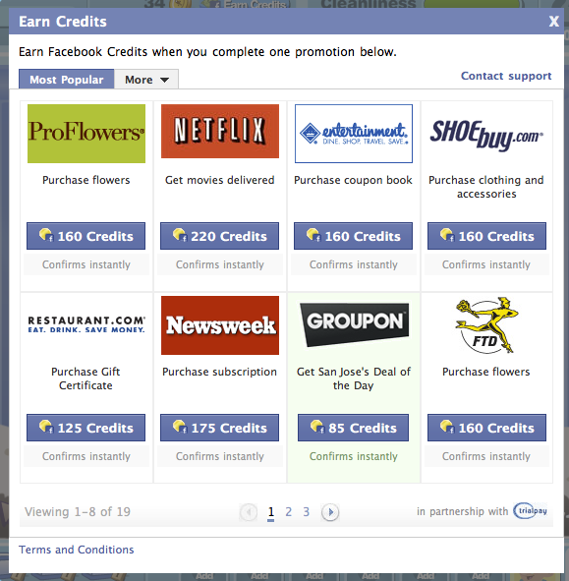
Example: Pre-Transaction Social Promotions
Pre

Slide 6


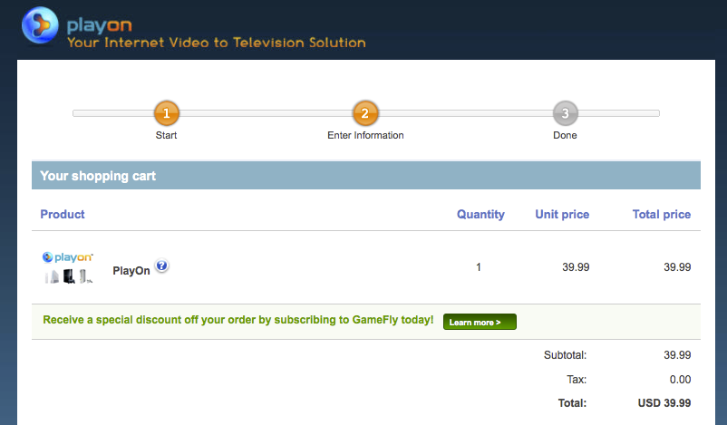
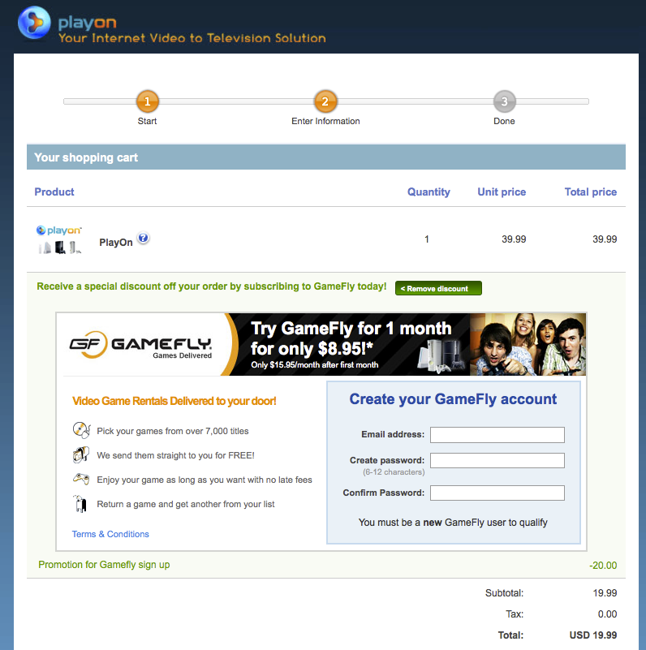
Example: In-Transaction Sponsored Discounts
In

Slide 7
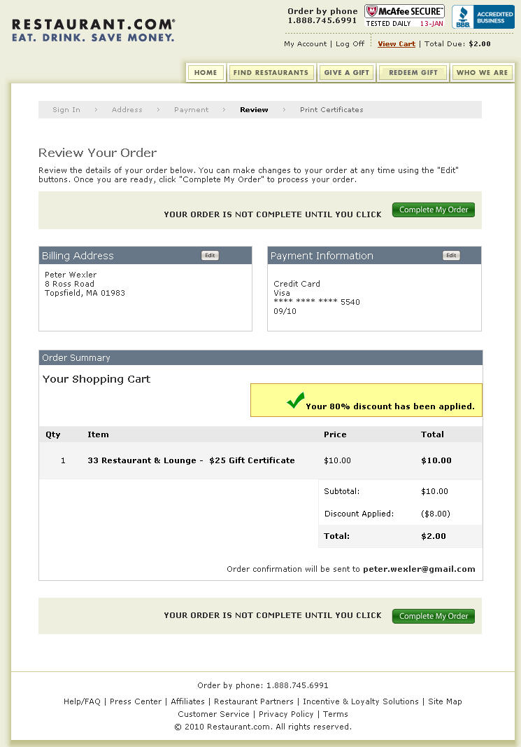
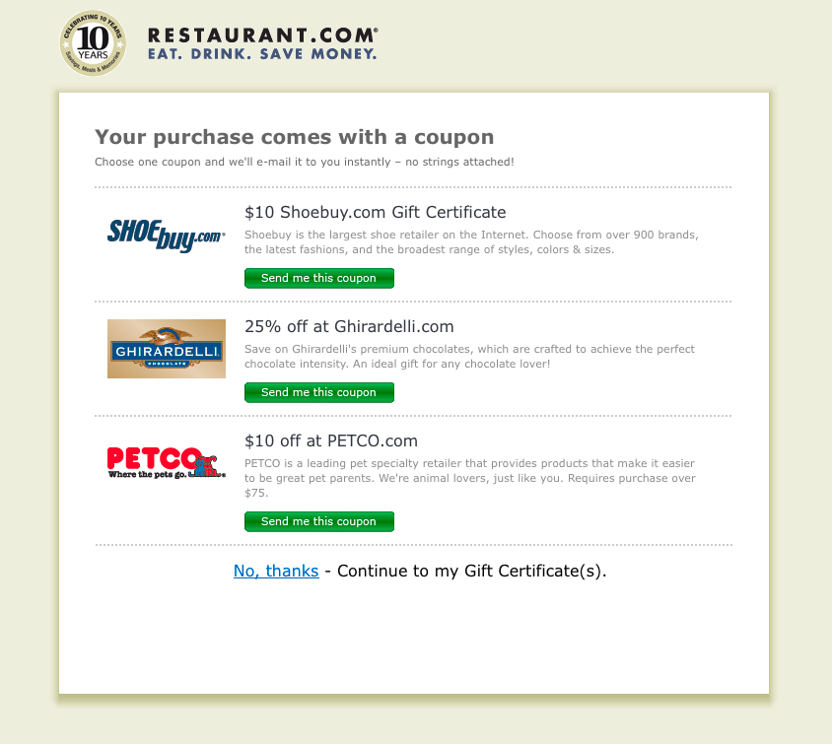
Example: Post-Transaction Coupons
Post

Slide 8
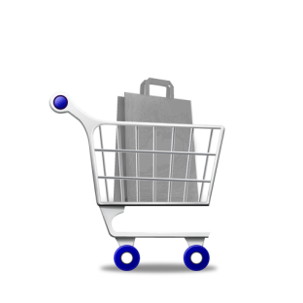





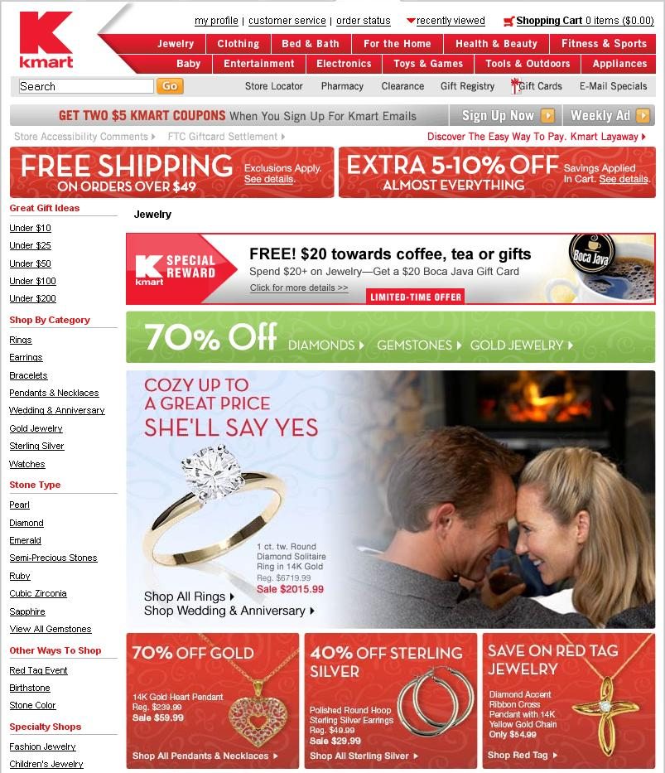







Transactional Advertising – Increasing Efficiency
Get an 8-hour credit for FREE
I won’t pay
FREE
Alternative Payment
Thank you for your order
ORDER
RECEIPT
I might pay
$10
off
Coupons
$5 off
Purchase Incentive/ Cash Back
WinZip 12
$29.95
I want to pay
Special Offers! Add to Your Cart & Save:
$9.95 (save $20)
$6.95 (save $15)
Cross-Sell
CART TOTAL:
$19.90
Checkout Now >>

Slide 9

Example: Snapfish and Flowers
Flower company pays to acquire customers
“Bad” customer for Snapfish = Great customer for FTD
Snapfish earns more $, more margin, from sending customers to FTD
Alternative payment

Slide 10







































Illustrative Partners

Slide 11







About TrialPay: Quick Stats
10,000+ Merchants use TrialPay’s payment platform
2,000+ Advertisers acquire customers through TrialPay’s CPA platform
60 Million+ Registered Users have signed up with TrialPay
Global Reach with transactions in 100 countries, and localized in 10 languages, including English, French, German, Swedish
CEO most recently co-founded SiteAdvisor (acquired by McAfee), leadership team from: Symantec, Trilogy, PayPal, Facebook
Investors include Battery Ventures ($2.9B), Index Ventures ($1.5B), Skype founders, former PayPal president

Slide 12
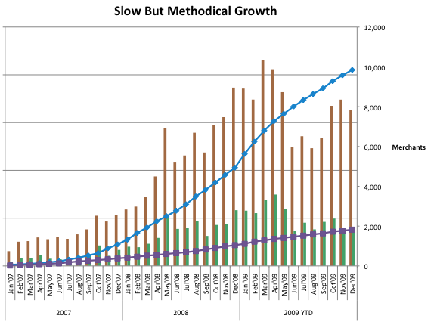
Long Road to 10,000 Clients

Slide 13
How We Got There: Vertical Focus, Channel, Expansion
Whether Facebook or NewCo: Focus on a “tight” vertical
Step one: Win the vertical first (Facebook: Harvard)
Step two: Expand the product (do more), or expand into other verticals. Reed Hastings rule (10x)
Step three: Go to step one
How to conquer the vertical?
Personal experience proved crucial – start with consumer software
“Friends of family” incredibly helpful towards winning first customers
Lots of little guys and cost-ineffective to do “sales” to them
100,000 little clients @ $500/year = $50M/revenue
Sales, Marketing, and Channel Deals

Slide 14









What is a Channel?
“Distribution Routes of Your Product to Customers”
Aggregators
Agencies
Airlines
Direct to Consumer

Slide 15
How a Large Channel Helps with Classic Problems
- What is the hardest problem to solve?
- What provides the most economic value to customers?
- What is the competitive landscape?
- What are the defensive moats/barriers to entry?
- What generates the greatest margins?
- What is the market size?
Notes:
These are classic “business school” questions that try to determine the equity value of a given company. If you solve a hard problem, great economic value to customers, vanquish competition, huge defensive moats, huge margins, great market size…bingo
<number>

Slide 16
For Our Business, Channel Is Instrumental for Little Guys
Channel

Slide 17
Routes to Market for TrialPay (example)
Technological and “Chronological” Stack
Channel Routes
Direct
Web Merchants

Slide 18




Referral vs Integration
Many of our channel deals simply involved “receiving” clients and sharing revenue, others take integration
Referral
Integration
White label/ acquisition
I would never be a “channel” to somebody if I’m growing 100%+ YoY!
Notes:
I would never send my clients to somebody else while we’re in a phase of high growth!
<number>

Slide 19
Tons of Opportunities
Fit, overlap, defensibility, revenue
PayPal
Authorize.net
Digital River
GoDaddy
Google
Download.com
eJunkie
Kagi
High
Top Priority
Potential Benefit
Citi
Chase
Topica
Intuit
TUCOWS
Web.com
Register.com
Pursue If Resources Allow
On Hold / Spin Cycle
Low
Low
High
Feasibility / Partner Growth Tapered
Size of organization, relevance, private/public, etc
Notes:
The least feasibility are companies that are growing very strongly in their core businesses
<number>

Slide 20
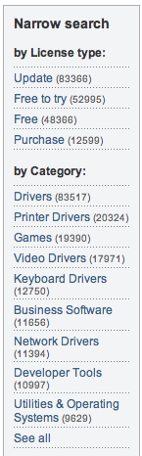
Download.com Perfect Channel Partner
64,000 Products
Defensibility by sending traffic to existing partners
Bi-directional relevance: needle-mover for both parties
Download.com eager to pursue new opportunities/revenue models
Network effects from increased traffic to advertising partners (e.g., Netflix, FTD, etc)

Slide 21
Vertical #1 Was Software, So Start with Download.com
Data suggests Download.com directly or indirectly accounts for about $190M in annual software sales¹
Total potential revenue to CNET could be 40% of this
Conservative Projection: $XM/year in CNET net revenue
Addressable
Market
1. Assumes 1% download-to-pay conversion rate and $30 median selling price

Slide 22
Also Aids Defensibility
Consumer Traffic
Merchants
TrialPay
Vulnerable!
Turn into…
Merchants
Consumer Traffic
TrialPay

Slide 23
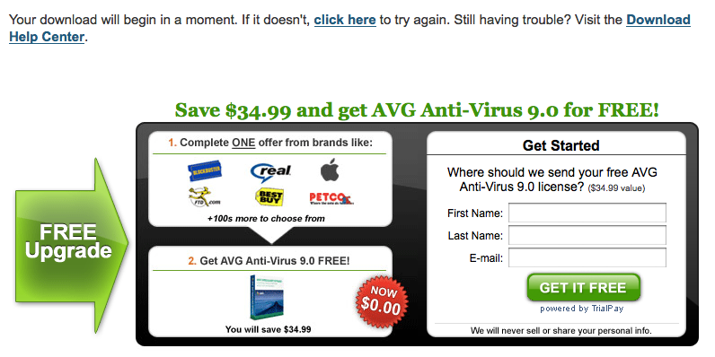
Plug-and-Play for Monetization Post-Download
Provide free options across all downloads at Download.com
Led to thousands of new merchant deals
Strong pillar of defensibility since traffic comes from Download.com via TrialPay

Slide 24
What About Pricing?
Cardinal rule of “Channel Conflict”
Channels should not compete with each other on price
However…
Channel partners can be offered different economics (e.g., Hilton pays Amex more than Orbitz)

Slide 25



Download.com Pricing Plan
Since Download.com drives distribution, they can command a fee from our clients
This is a standard “affiliate” model
$12
$6
$12
$30

Slide 26


Proven Distribution Channel, Now Expand
Business development team contacted every download site
“We have download.com” made sales pitch easy
More distribution/defensibility for software vertical
Profitable sales channel due to aggregating effects
etc…

Slide 27
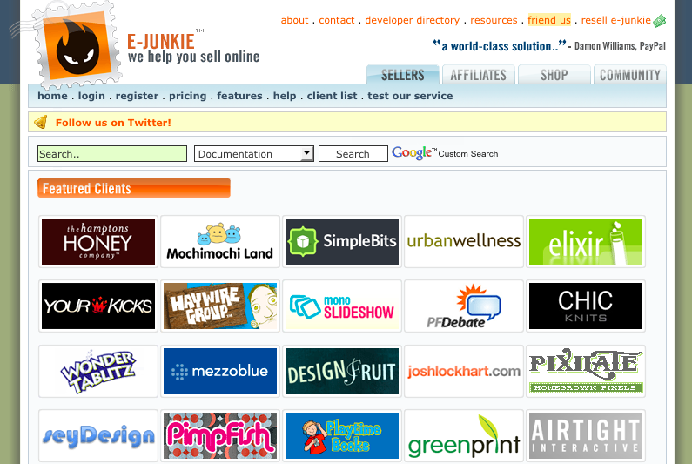
Channel #2: More Small Merchants
PayPal taking too long (still trying)…so:

Slide 28
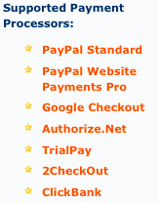
Distribution Deal
eJunkie added us as a payment type
Pricing = $ out of our pocket (same economics for merchants)
Little defensibility, but significant channel growth and usage
Formula works, repeat with 10, 20, 30 more eJunkies
Practice for the big fish (e.g., PayPal)

Slide 29
Summary: The Power of Channel
Channel deals are key for virtually every company
Every deal is looked at from a defensibility, distribution, and profitability lens
Complementary goods are the key poaching grounds for “new” concepts (not like Hilton <-> Hotels.com, or Pepsi <-> Pizza Hut)
Direct relationship with the consumer is most valuable – ideally you have the relationship, not the channel provider

